Slide 1
AWS Architecture
Sunith Kumar
Techie Horizon
18/ Sep/ 2026
Devops engineer POV(Myntra Application)

Slide 2
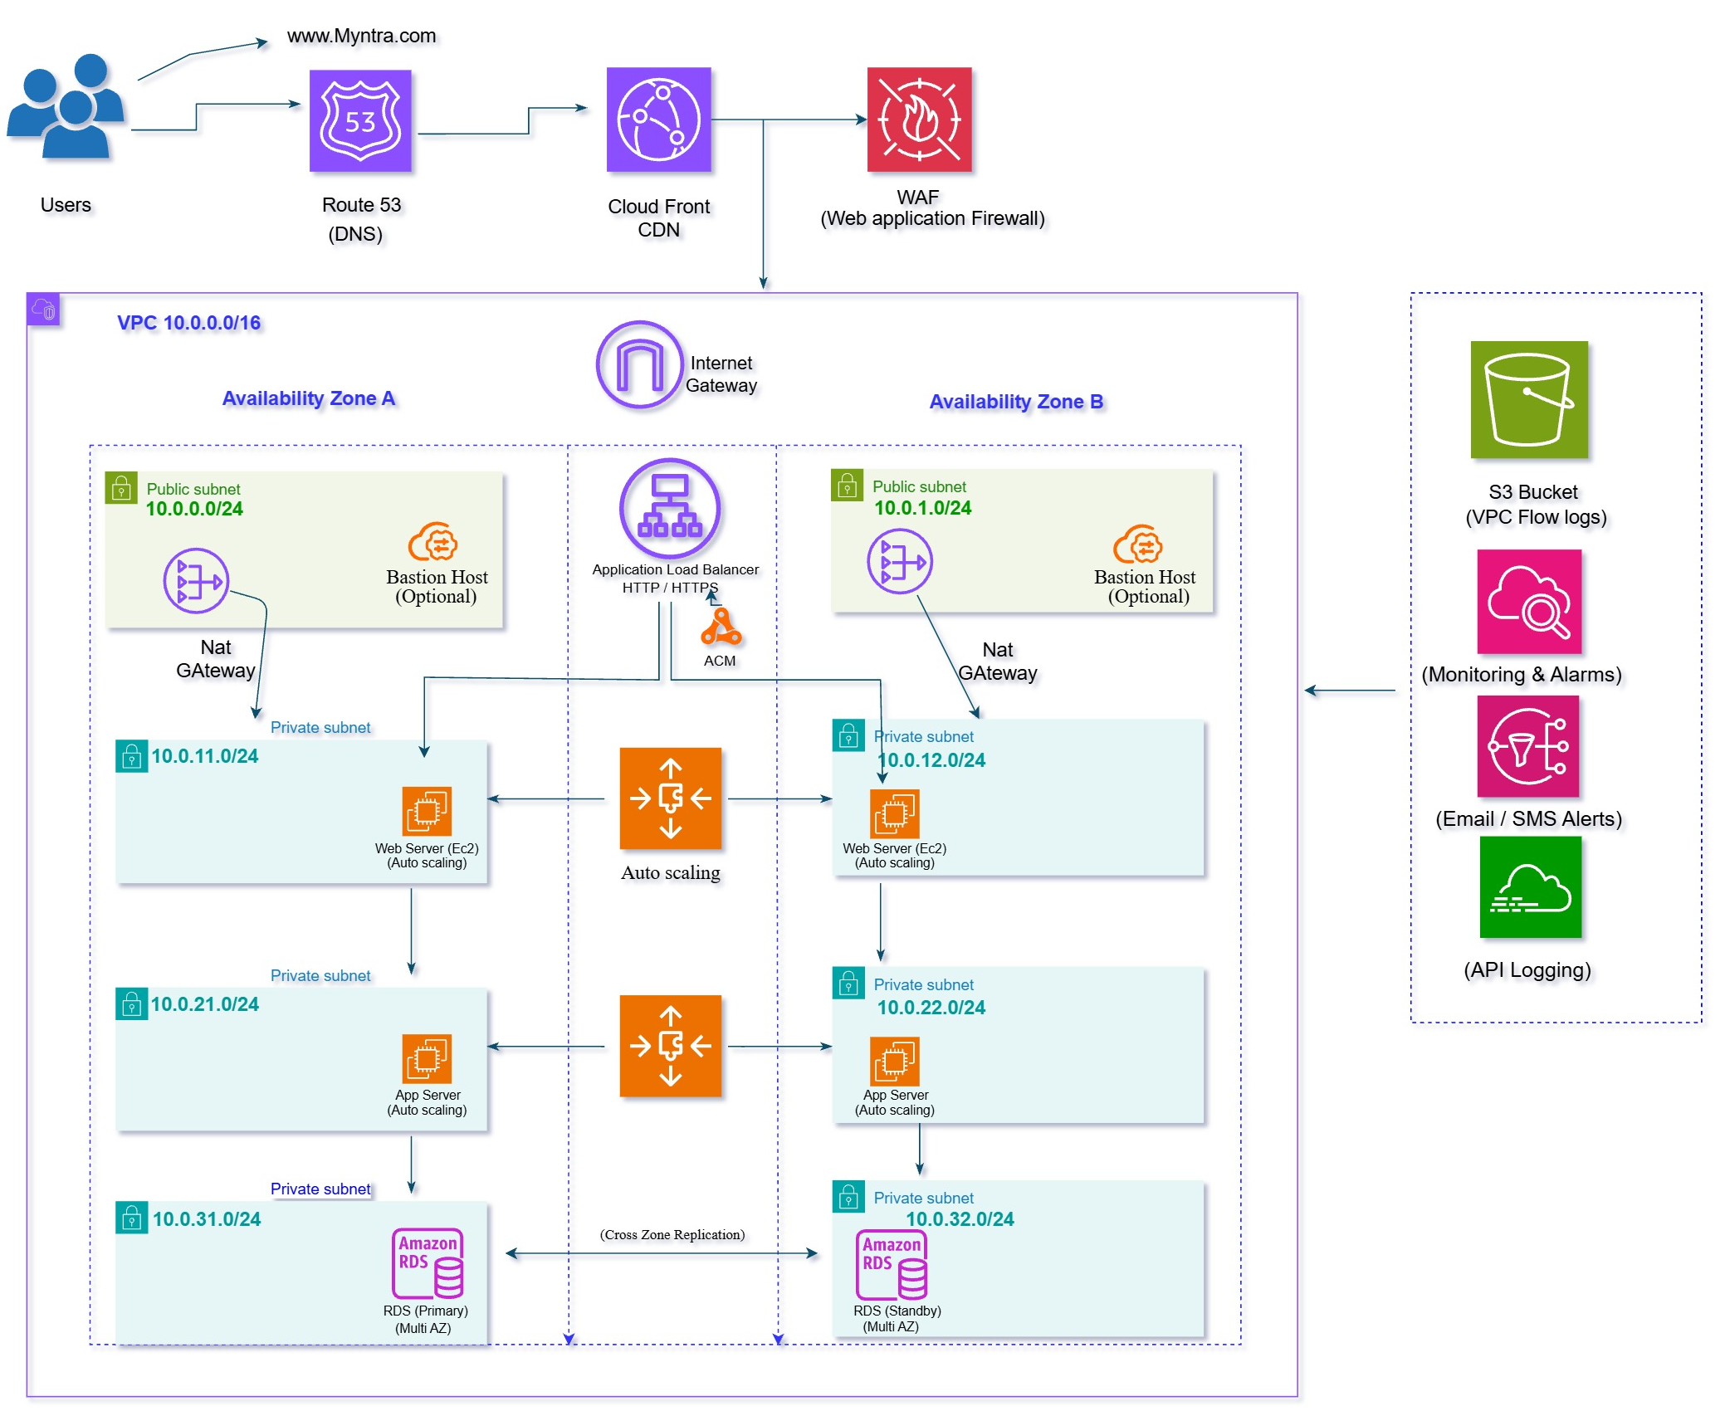

Slide 3
Thank you

